Slide 1
Automated Handwriting Recognition of English and Native Indian Languages with Deep Learning
Project by
Souporno Ghosh
Soumya Nasipuri
Rahul Roy
Sharanya Saha
Under the Guidance of
Smt Jaya Paul

Slide 2
Motivation
Shortage of Research in Native Indian Language Recognition
Authentication of Manuscripts
Forensic Analysis and Law Enforcement
Plagiarism Verification

Slide 3
Software Used
Python 3.8
TensorFlow 2.0
Keras
NumPy
Pandas
Mat Plot Lib
PyPlot
SeaBorn
VGG16

Slide 4
Hardware Used
HP Pavilion with Intel i5 Quad-Core, Integrated Graphics Card, 8GB RAM
Dell G3 with 2.6GHz Hexa-Core Intel i7 Processor, Integrated Graphics Card, 8GB RAM
Asus Vivibook 2GHz Quad-Core AMD Ryzen 5 Processor, Integrated Graphics Card, 8GB RAM

Slide 5
Significance of the Hardware
RAM and Processor for Processing Speed
GPU Might Help!

Slide 6
Collection of Data Set
121 volunteers
Handwritten Passage
Bangla Text in our project

Slide 7
Preparation of Data Set
Noise Eliminated
Word-sized Segments
Each DataSet has 20 Folders
Every Folder has Data for 2 Authors
5 Sets of Data for Each Author Pair
3 Training Sets and 2 Testing Sets
Tag Image File Format
Format: <Author Code>_<Set Number>_<Image Number>
5 Data Sets in Total

Slide 8
Background
Works on Image Recognition and CNN
ImageNet classification with deep Convolutional Neural Networks
Very Deep Convolutional Networks for Large-Scale Image Recognition
Works on Character Recognition
Automatic Visual Features for Writer Identification: A Deep Learning Approach
Handwritten Character Recognition of South Indian Scripts: A Review
A High Performance Domain Specific Ocr For Bangla Script
Bangla character recognition based on Mobilenet v1 and Inception v3
CNN implementation based on Bangla numeral character recognition
Works on Writer Recognition
Offline writer identification using convolutional neural network activation features
Writer identification using an HMM-based handwriting recognition system: To normalize the input or not
Offline Text-Independent Writer Identification Based on Scale Invariant Feature Transform

Slide 9
Summary of Present Work

Slide 10
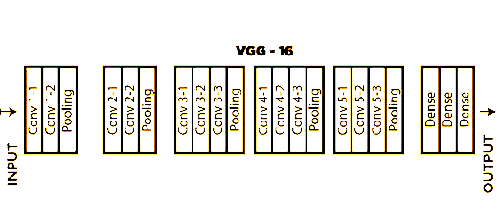
About VGG16 Model
Proposed by Simonyan and Zisserman in 2014
92.7% accuracy with the ImageNet Database
16 Neural Network Layers
13 Convolutional Networks
3 Dense Networks

Slide 11
Challenges of VGG16
Slow to Train
Big Size

Slide 12
The Architecture of VGG
import keras
import os
from keras.models import Sequential
from keras.layers import Dense, Conv2D, MaxPool2D, Flatten
from keras.preprocessing.image import ImageDataGenerator
from keras.callbacks import ModelCheckpoint, EarlyStopping
from keras.preprocessing import image
from keras.models import load_model
from keras.optimizers import Adam
import numpy as np
import matplotlib.pyplot as plt

Slide 14
Feature Extraction

Slide 15
Program Walkthrough

Slide 16
What comes next

